Slide 1
Observational Strategy Sub-Group
Extragalactic Astrophysics and Cosmology Group Study 2013
Michael O’Neill, Joe Baumber, Catherine McDonald, Dorothy Stonell, Rahim Topadar, John Shepley

Slide 2
Introduction
Group Aims
Detection Methods
Colour
Gravitational Lensing
Wide Survey
Deep Survey
Spectroscopy

Slide 3
Observing Strategy Aims
To formulate an observing strategy capable of observing the EoR.
Focus:
Observing the high-z beginning of the EoR to further the understanding of structure formation.
Taking advantage of future advancements.
Creating a strategy able optimised to reduce the observation time required.

Slide 4
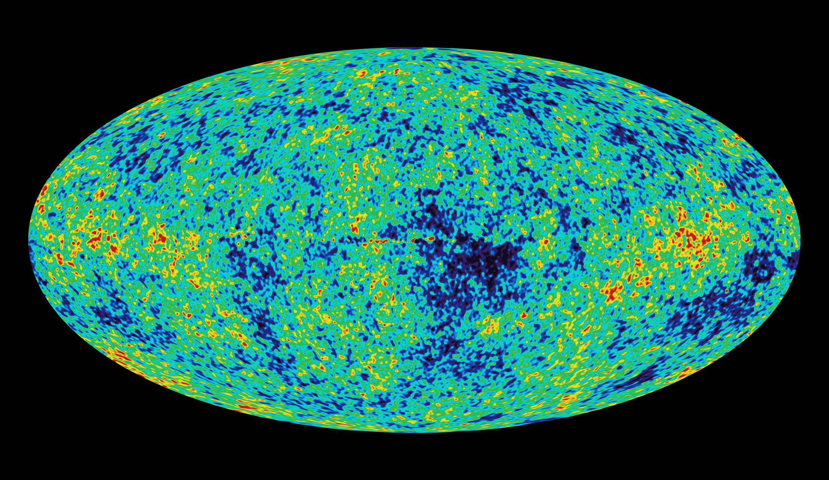
Detection Methods
CMB anisotropy
21 cm line
Dropout method
CMB anisotropy
Notes:
After CMB released, photons encountered observable Thomson scattering off of free electrons leaving secondary anisotropies on the CMB map. By comparing observations with models of how universe would appear without Reionization having happened measurements of the electron column density can be made. From this it is possible to calculate the period over which EoR occured.

Slide 5
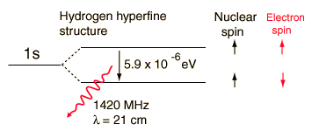
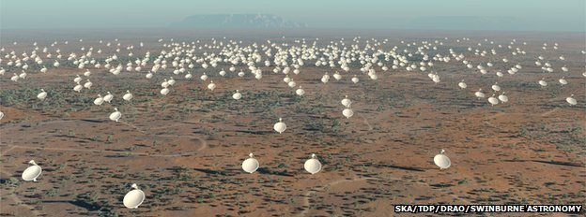
21 cm line
Notes:
21cm – emission line from hyperfine transition between Hydrogen 1s ground state. Ionized hydrogen will appear as holes in the 21cm background.
Observed using radio arrays such as the planned SKA across Australia and Africa. Can be used to provide very accurate picture of the Hydrogen makeup of the Universe following recombination.
Lots of interference from all the radio transmissions we use day to day, located in secluded areas. Proposals for projects operating on the dark side of the moon have been made to compensate. Seen to be the next generation of Observational cosmology but still some way off at present.

Slide 6
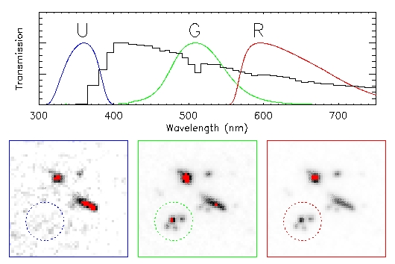
Lyman-Break Galaxies
(Dropout Method)
Notes:
Photometry techniques – Taking images of the first star-forming galaxies in 3 different filters. We choose these filters so we expect to see flux in 2 bands and an absence of flux in one. This absence in flux is due to the photons being blue-ward of the Lyman-limit and are able to ionise netural hydrogen, i.e. They got lost on their way to us. Many proposed telescopes on their way; JWST, Euclid, E-ELT which will be able to see further back than ever before with vastly improved accuracy.

Slide 7
Colour
Defined as difference in magnitudes between bands
For Lyman break galaxies, there will be a large decrement in colour for a band situated on the break and blue-ward of the break, due to the absorbtion of the flux by the Gunn-Peterson effect.
But what about Contaminants?

Slide 8
Contaminants
Photometric scatter, interlopers, (dwarf stars, galaxies at intermediate redshift)
To eliminate the contaminants, restrictions can be placed upon the data using another filter red-ward of the filter containing the drop
From these two colour values for each object observed, a colour colour diagram can be made with a colour window for our target objects, eliminating most contaminants

Slide 9
Telescope filters chosen for colour
Hubble
Can see colour information up to approx. z=10
James-Webb
Able to observe colours for all redshift ranges, but will most likely be used for z>10
E-ELT
Doesn’t have correct filters for colour selection for z 10-15
Euclid
Colour information only up to z=10

Slide 10
Hyper-z
Can create a catalog of synthetic lyman break galaxies in a particular redshift range
Can give magnitude in a certain filter using transmission files using a reference filter with a certain magnitude, with a sample spectrum
Colour-colour diagram can be formed to show statistical grouping of galaxies, so a colour window can be found
Magnitudes found in Vega, so AB magnitude conversion needed.

Slide 11
Make_catalog process
Reference filter chosen for a redshift range. Must contain observed red-shifted wavelength of the rest frame 1500A wavelength over the redshift range
Magnitude can be obtained from Predictions group from observed luminosity function of 1500A
Program then uses a sample spectrum to convert this magnitude to what it would be in other bands

Slide 12
Other factors
Formation of Stars- assumed to be ‘burst’, galaxies form over small time scale, good approxiation for high-z universe
Formation red shift assumed to be z=20
Galaxies at same redshift assumed to be same age, i.e. observed age = T(formation redshift)-T(current redshift of galaxy)
No Reddening law assumed, future research

Slide 13
Colour colour diagram results

Slide 14
Gravitational Lensing

Slide 15
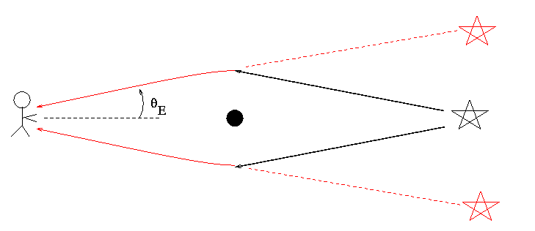
Gravitational Lensing
Magnification of distant sources
Einstein ring if perfect alignment
More likely to observe 2 arcs centred on lens
Azimuthal angle of images constant

Slide 16
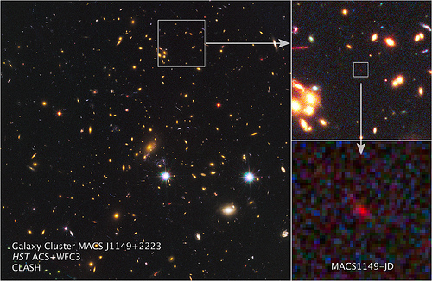
Option 1: Known Lenses
Limited number known ~50
Known mass, velocity dispersion and radius
Cluster Lensing And Supernova survey with Hubble (CLASH)
25 x-ray selected clusters
Found a lensed candidate z=11.9 galaxy
MAssive Cluster Survey (MACS)
On-going survey
So far >100 spectroscopically confirmed clusters at 0.3 ≤ z ≤ 0.7

Slide 17
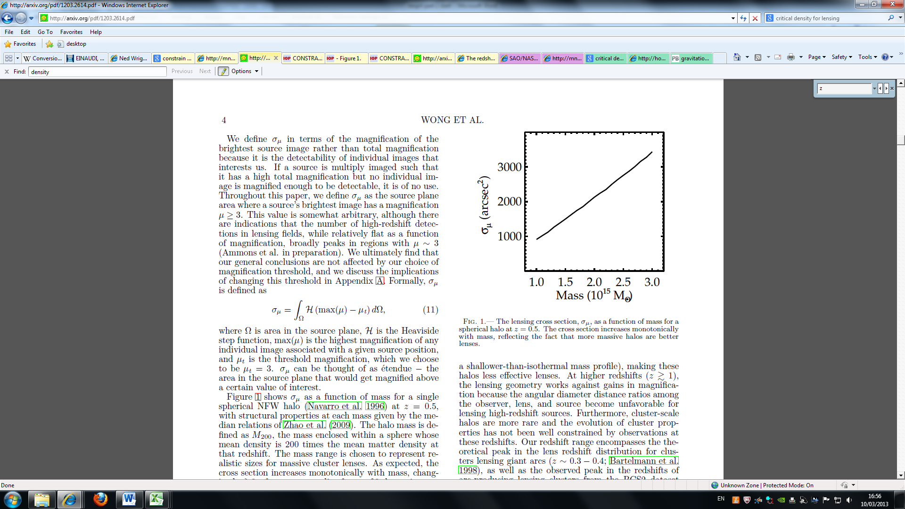
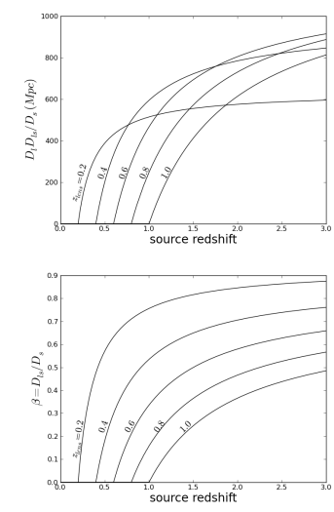
Option 2: Locate New Lenses
Select using strong lensing
Specific selection criteria
Area of sky
Away from bright contaminants
Compatible with telescopes
Redshift range
Shear (shape distortion) is greater at higher lens redshifts
Einstein angle greater at lower lens redshifts
Optimum around z=0.6

Slide 18
Gravitational Lensing Summary
Trade off between viewing area and source magnification
Use lensing to supplement deep survey

Slide 19
The Wide Survey

Slide 20
Aims of wide survey and picking a telescope
Aims:
Lower redshift candidates
Lensing
Suitable areas for deep survey
Choosing a telescope for the wide survey
E ELT
Euclid
JWST
 | Time
Area | JWST | Euclid | E ELT
1 FoV | 0.79 hours | 6.1 hours | 1.33 hours
0.51 degrees | 12.23 days | 6.1 hours | 4.0 days
1 degrees | 24.46 days | 0.46days | 7.98 days
40 degrees | 978.44 days | 18.42 days | 319.40 days
 | JWST | Euclid | E ELT
FoV (degrees) | 0.00134 | 0.551 | 0.00694

Slide 21
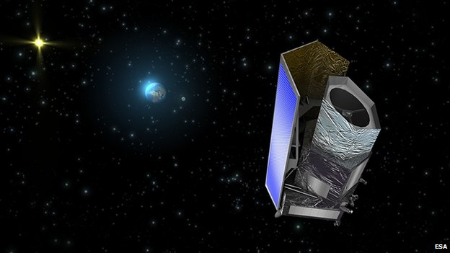
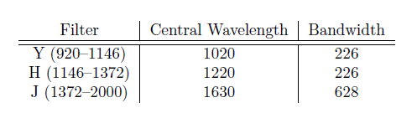
Euclid
Planned for launch 2018
Near IR, spectroscopy and visual photometry
Limitations
Small mirror diameter (1.2 m Korsh telescope)
Redshift range
Uses
Large field of view
Gravitational lensing
Lower redshift candidates

Slide 22
Euclid surveys and Exposure times
Wide survey
24th mag AB
Gravitational lensing
Narrow survey
26th mag AB
Higher redshift galaxies
Spot better lenses
How long will the surveys take?
Euclid documents estimate 6.5 years for survey completion
Wide survey- 1 pointing at each patch of sky
Narrow survey
4-6 months continuous
6 years spread over wide survey

Slide 23
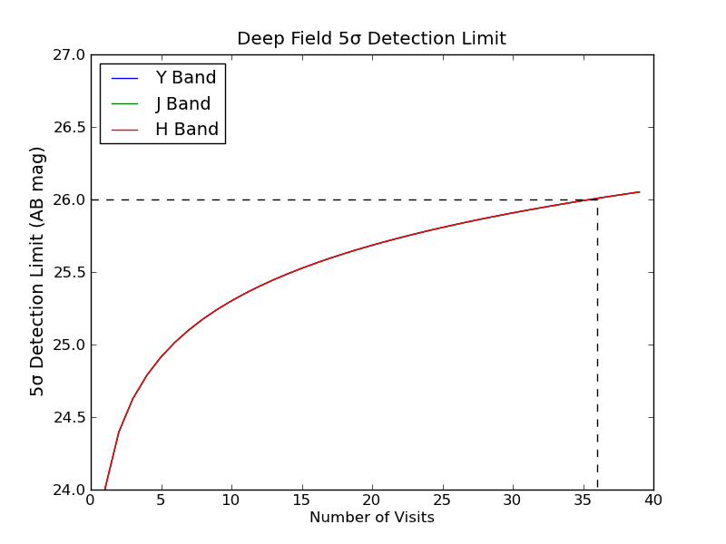
40 exposures

Slide 25
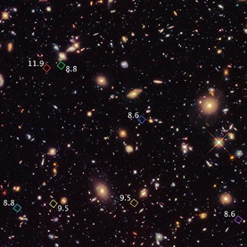
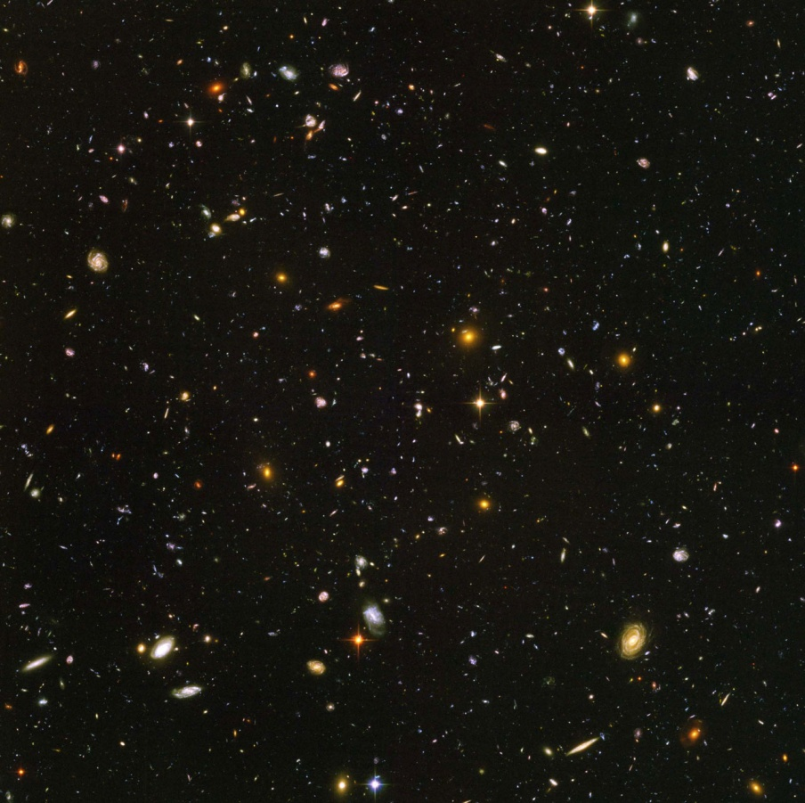
The Deep Survey

Slide 26
What has been gained from the wide survey?
Find galaxies at low redshift
Will identify gravitational lenses
Identify foreground contaminants

Slide 27
Deep survey
Will be able to view high redshift galaxies
Look more closely at candidates
Confirm by detecting in multiple bands

Slide 28
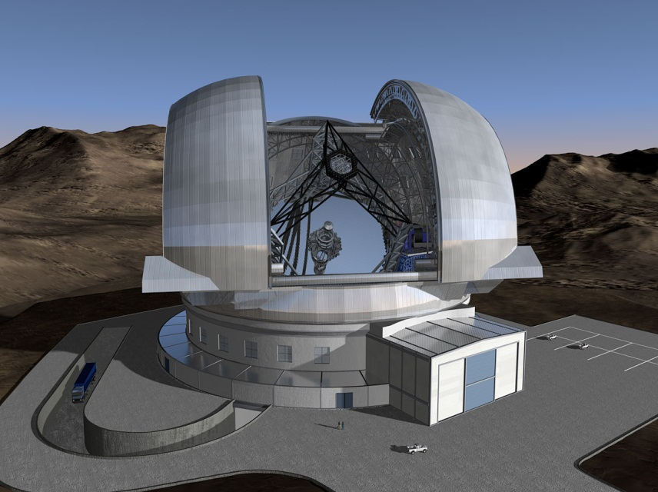
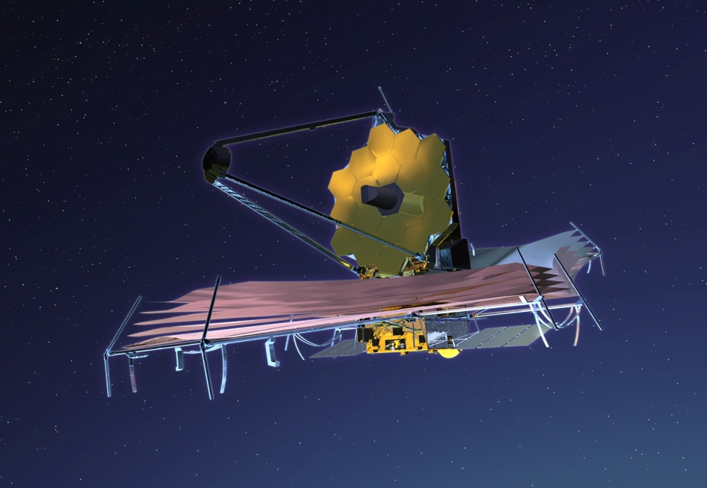
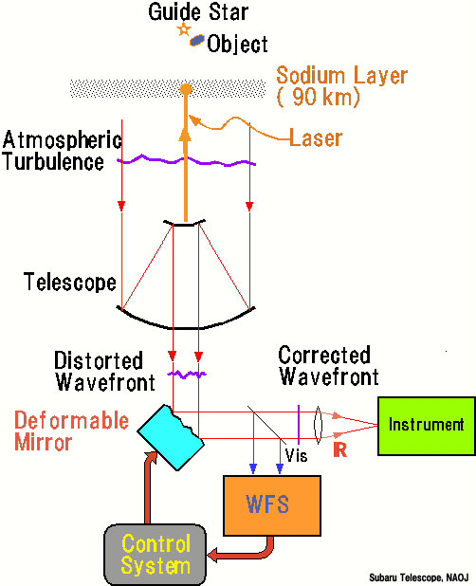
E-ELT
JWST
VS
Adaptive optics

Slide 29

Calculating Observation Times
Euclid | Photons |  | 0.13 | 0.02
 | a |  | 0.02 | 0.00
 | b |  | -355.45 | -343.91
 | c |  | -929710.36 | -929710.36
 | Time (Seconds) |  | 22529.38 | 1152557.36
 | Time (Hours) |  | 6.26 | 320.15
 | # of Exposures |  | 1.84E-02 | 1.52E-01
E-ELT | Photons |  | 52.32 | 6.82
 | Time (Seconds) |  | 19165.65 | 1128378.67
 | Time (hours) |  | 5.32 | 313.44
 | # of Exposures |  | 36.82 | 1775.80
JWST | Filter |  | 0.151 | 0.5
 | Photons |  | 0.81 | 0.35
 | a |  | 0.66 | 0.12
 | b |  | -786.13 | -739.92
 | c |  | -3064501.29 | -3064501.29
 | Time (seconds) |  | 2828.61 | 8830.70
 | Time (Hours) |  | 0.79 | 2.45
Overheads: Readout Time
Transmission
Cosmic Rays
Changing Filters

Slide 30
Spectroscopy
What is it?
- Dispersing light from a source into constituent wavelengths
- Hydrogen alpha emission line
How does it work?
- Dispersion Medium (Gratings or Prisms)
- Slits
- Collimator
- Blazing

Slide 31
Telescopes considered for use
JWST
- NIRSpec
- Integral Field Spectroscopy
E-ELT
- HARMONI
- SIMPLE
- EAGLE

Slide 32

Exposure Times Calculations
$R=\frac{λ}{Δλ}$
$Δλ$ is the spectral resolution element
Results

Slide 33
Thank you for listening, we hope you enjoyed it. We welcome your questions.

